Slide 1
Working With The Couchbase .NET SDK .NET Workshop

Slide 2
Introduction
Goals
Prerequisites
SDK/Client installation
Using the Couchbase .NET SDK

Slide 3
Goals
Hands-On workshop
Best Practices Discussion through discussions and examples
Coverage:
Integrating the .NET Couchbase client into a Visual Studio Solution
Creating and Managing Connections
Configuring Timeouts
Working with Documents
Queries
Durability and Locking
Logging

Slide 4
Prerequisites
Couchbase Server 4.x installation
Beer-sample bucket
Visual Studio 2015

Slide 5
Getting the .NET SDK
The latest Couchbase .NET Client is available via NuGet for Visual Studio
Can be installed via Package Manager or via NuGet command line in Visual Studio

Slide 6
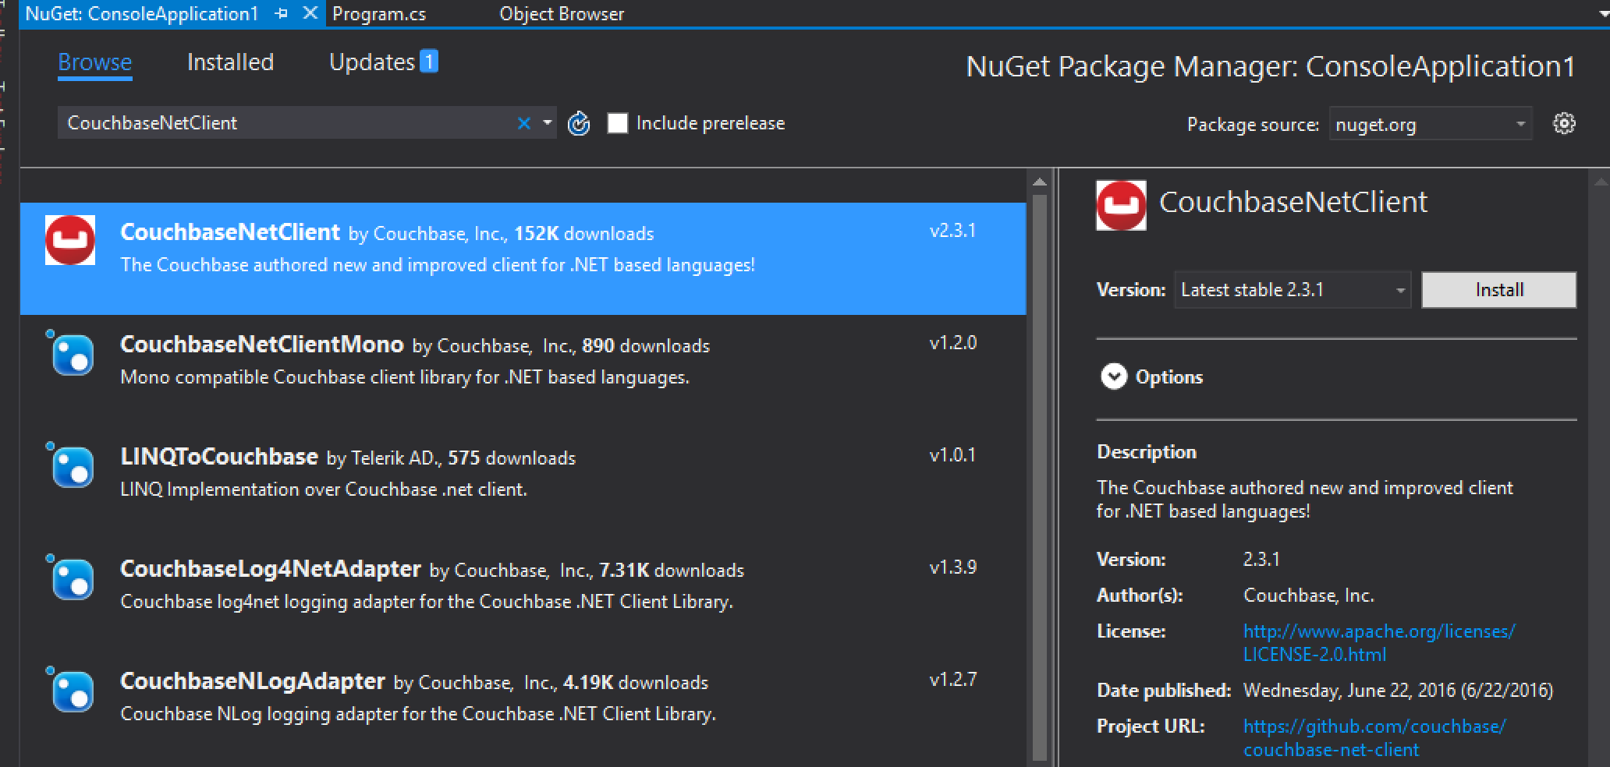
Nuget package manager GUI

Slide 7
Nuget command line

Slide 8
Managing Connections

Slide 9
Managing connections
Module goals:
Introducing the Bucket and Cluster objects
Connecting to a Cluster
Discuss Auto-Sharding
Programmatic Configuration
Configuration via web.config/app.config
Using and configuring the ClusterHelper

Slide 10
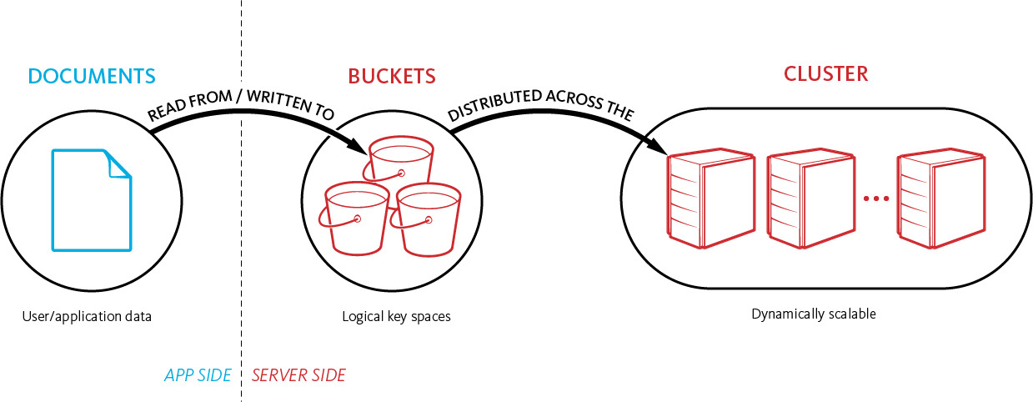
Storing And Retrieving Documents
Notes:
KEY POINT: GROUND THE USER IN HOW OBJECTs RELATE TO BUCKETS AND THOSE ARE SPREAD ACROSS THE CLUSTER; AS WELL AS HOW THINGS IN THE CLUSTER ARE STACKED PHYSICALLY.
Talk to the audience about how documents move in the application at a high level and the relation between data buckets and how they are spread evenly across the cluster.
Remember that vBuckets are not in this diagram, but that is on purpose. That comes later and might confuse people at this point. Going over this slide now sets you up for the vBucket discussion later in the presentation.
Convey what a bucket is. That it is a logical key space, with its own set of server resources, queues, etc.
Make sure to stress that one can have multiple buckets, but to not just create them like you would tables or schemas in a relational database
An example of when to split data into different buckets is using Views across different object types. For example, if you have JSON documents and base64 encoded XML documents in the same bucket, a view or index will have to interact with that object even though it will never need it. So it would be better to put the XML into another bucket so the views and indexes are only looking at the JSON data they actually will be indexing.

Slide 11
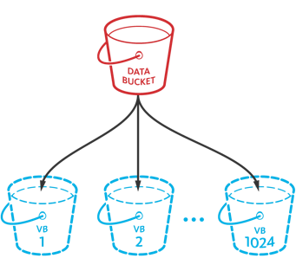
Auto sharding – Bucket and vBuckets
A bucket is a logical, unique key space
Multiple buckets can exist within a single cluster of nodes
Each bucket has active and replica data sets (1, 2 or 3 extra copies)
Each data set has 1024 Virtual Buckets (vBuckets)
Each vBucket contains 1/1024th portion of the data set
vBuckets do not have a fixed physical server location
Mapping between the vBuckets and physical servers is called the cluster map
Document IDs (keys) always get hashed to the same vbucket
Couchbase SDK’s lookup the vbucket -> server mapping
Virtual buckets

Slide 12
Cluster Map
Notes:
The application makes a call for a key called NYC MQ1
We run the key through the crc 32 function and the result of that hash function is that it points to vbucket3
Which in turn points to couchbase server number 1

Slide 13
Cluster Map
Notes:
We now run a different key through through the has and we now come up with different vbucket, vbucket 4 and that points to server 3

Slide 14
The Bucket object
Provides all methods for accessing documents stored in a Couchbase Data Bucket
Retrieved from a Cluster object or the ClusterHelper static methods

Slide 15
The Cluster object
Represents a Couchbase Server instance
Can be a single server or a cluster of Couchbase Server installations
Is “vBucket aware”– client maintains a map of vBuckets, and which servers they reside on.
Notes:
Show how to pull the vBucket map (install JSON Editor) from Couchbase server. Map does NOT contain each individual key.

Slide 16
Auto sharding – Bucket and vBuckets
A bucket is a logical, unique key space
Multiple buckets can exist within a single cluster of nodes
Each bucket has active and replica data sets (1, 2 or 3 extra copies)
Each data set has 1024 Virtual Buckets (vBuckets)
Each vBucket contains 1/1024th portion of the data set
vBuckets do not have a fixed physical server location
Mapping between the vBuckets and physical servers is called the cluster map
Document IDs (keys) always get hashed to the same vucket
Couchbase SDK’s lookup the vbucket -> server mapping
Virtual buckets

Slide 17
Configuring the Cluster object
Uses a ClientConfiguration object for setting:
Server addresses in a cluster
Bucket Configuration
Can be used to set default bucket configuration or per-bucket
Timeout configuration

Slide 18
Programmatic Cluster object configuration
Notes:
Need an icon to say “lab should be here”

Slide 19
Config-based configuration
Notes:
Need an icon to say “lab should be here”

Slide 20
ClusterHelper
Convenient method of quickly accessing Bucket objects
Caches Cluster and previously accessed Bucket instances to speed up database access
Manages Cluster connections
Should be used in long-running applications, such as web services or web sites where connections and buckets will be used over and over again
Configured using the same ClientConfiguration object as Cluster object
Notes:
Use at Application_Start, Application_End, (refer to documentation)

Slide 21
ClusterHelper ASP.NET Code Example

Slide 22
Timeouts
Timeouts can be managed for many different types of queries/connections
Defaults are usually fine
Timeouts should be changed after application profiling, as timeouts needing to be changed could indicate an issue with the application or database configuration
Notes:
Should minimize the number of hops between application servers and database servers, ideally on the same subnet/physical network. These defaults shouldn’t need to be changed under ideal circumstances.

Slide 23
Working With Documents

Slide 24
Working with Documents
Module Goals:
Explore Document Fundamentals
Explore the methods of the Bucket object for working with single documents
Explore Bulk operations
Explore Atomic Operations

Slide 25
Document Fundamentals - Composition
Value
Metadata
Document ID / Key
Document
Document ID or Key
Similar to primary keys in relational databases
Documents are partitioned based on the document ID
ID based document lookup is extremely fast
Must be unique
Value
JSON
Binary - integers, strings, booleans
Common binary values include serialized objects, compressed XML, compressed text, encrypted values
Metadata
CAS Value (unique identifier for concurrency)
TTL
Flags (optional client library metadata)
Revision #
Notes:
Keys in Couchbase are analogous to primary keys in RDBMS
Values are the payload of your data and can be represented in many different formats, with JSON formats being a special class that can be used to index your data in Couchbase
Couchbase adds metadata to your object to support additional functionality like locking, expiry, replication, and conflict resolution

Slide 26
The Bucket Object
The Bucket is the object used for interacting with documents within a Couchbase Server instance.
5 main methods:
Get
Returns IDocumentResult
Insert
Upsert
If a key does not exist, Insert it.
If a key does exist, Update it.
Replace
Remove
Notes:
Discuss async methods and sync methods
When to use sync versus Async?
Discuss Upsert versus Insert or Update

Slide 27
Inserting a Document

Slide 28
Upserting a Document

Slide 29
Replacing a Document

Slide 30
Removing a Document

Slide 31
Bulk operations
The Bucket object also provides bulk overloads for certain methods:
Get
Upsert
Methods take a Dictionary<string,T> containing the objects to be worked with.
Methods return an object that can be used to check the result of each insert.
Overloads accept ParallelOptions to control the amount of threads generated during query processing.
Notes:
Mention sync vs async

Slide 32
Atomic Operations
Atomic operations enable modifications of individual fields within a document
Useful in social media or gaming applications to track usage of certain features or upvotes/downvotes
Increment/Decrement are used for 64-bit integers
Append/Prepend add a value to the back or front of a field
Methods should NOT be used on fields that existed when documents were Inserted/Upserted
Notes:
Differentiate between *counters* and ACID compliance. This is *counters*.

Slide 33
Working With Queries

Slide 34
Working with queries
Module Goals:
Identify the different types of queries and views available in Couchbase Server
Explore MapReduce Views
Explore N1QL Queries
String-based
Prepared statements
Explore Geo Spatial Views

Slide 35
MapReduce Views
MapReduce Views are written in JavaScript and stored within Couchbase Server
Has a Fluent interface that allows method chaining to constrain type and amount of results returned
Uses IViewResult object to return results and indicate success or failure of queries
Query failure reason is available via the Error and Message properties of IViewResult object

Slide 36
MapReduce Query Example
Return first 5 results from MapReduce View
Determining failures returned from querying MapReduce View.

Slide 37
N1QL Queries
N1QL queries can be used in two ways:
String queries
Prepared statements
String queries are static queries supplied to Couchbase Server as a single string
Prepared statements are parameterized queries supplied as a string and a list of parameters
Prepared statements have execution plans stored within Couchbase Server for later use
Identified by using the AdHoc(false) fluent extension of the QueryRequest object.
Both types of queries use the IQueryResult object to return results
Like the IViewResult object, query failure can be determined through the Error and Message properties
Notes:
SQL injection type issues still a concern, show how parameterized queries could improve performance

Slide 38
Using a static N1QL Query
Return all results from a static N1QL query

Slide 39
Using a prepared N1QL statement
Return all results from a prepared N1Q1 statement. Notice the .AdHoc(false) indicating the statement is not AdHoc

Slide 40
Geo Spatial queries
Geo Spatial queries are used for identifying documents by X/Y coordinates
Geo Spatial data are mostly used for representing locations on a map
Documents containing Geo Spatial data must conform to the GeoJSON specification
Geo Spatial views return an IViewResult, just like MapReduce views.
Error and Message properties contain information about query failure

Slide 41
Querying against a Geo Spatial view
Returns the first point in the start and end range of the query. Runs against the “beer_ext_spatial” Geo Spatial view in the beer-sample database.

Slide 42
Durability and Concurrency

Slide 43
Durability and Concurrency
Module goals:
Discuss Optimistic versus Pessimistic durability
Explore CAS Durability model
Explore Enhanced Durability
Explore replication options via PersistTo/ReplicateTo method arguments
Explore Locking in conjunction with CAS

Slide 44
Concurrency models
Optimistic
Application assumes that the document won’t be modified between the time it’s accessed and when it is saved.
CAS and Enhanced Durability are Optimistic
Pessimistic
Application assumes that the document might be modified between the time it’s accessed and when it is saved.
Pessimistic Concurrency is enforced through Locking
Notes:
Always try to prefer Optimistic over Pessimistic

Slide 45
CAS Durability
CAS stands for “Check and Set”
Couchbase Server returns a CAS value with each result
CAS value is checked at the server to see if it was the same as when accessed. If not, document can be re-retrieved for latest update, then updated in code.
The CAS field should be treated as a byte[8] type and should never directly modified by application code.
“Optimistic” concurrency model

Slide 46
CAS Demonstration

Slide 47
Enhanced Durability
A faster, more reliable approach to durability than CAS.
Uses a sequence number rather than the CAS value returned.
More reliable in high availability, highly concurrent scenarios.
Works regardless of persisted/replicated states.
Configurable per-bucket, or as default bucket configuration when instantiating Cluster object.
Optimistic concurrency model.

Slide 48
PersistTo/ReplicateTo
Using either CAS or Enhanced Durability, PersistTo/ReplicateTo can be used to manually specify replication/persistence options
ReplicateTo specifies how many servers have in-memory copies of the document before the query successfully returns
PersistTo specifies how many servers have on-disk copies of the document before the query successfully returns
Available with Insert and Upsert methods
If options supplied exceed the amount of servers available in cluster, a ReplicaNotConfiguredException is thrown

Slide 49
PersistTo / ReplicateTo example

Slide 50
Pessimistic Locking
Used with CAS concurrency model
Can be used when an explicit lock is needed on a document
Document is locked for 15 seconds by default
This default can be modified if needed
Document is locked/unlocked via a Bucket method call, supplying the document’s key and the CAS value.
If a document is locked, the CAS value in the document metadata will be -1, or 0xffffffffffffffff in hexadecimal.

Slide 51
Pessimistic locking using Lock/Unlock

Slide 52
Logging

Slide 53
Logging
Module goal:
Learn to set up logging via NuGet and Log4Net
Explore the various log levels
How to enable different logging levels

Slide 54
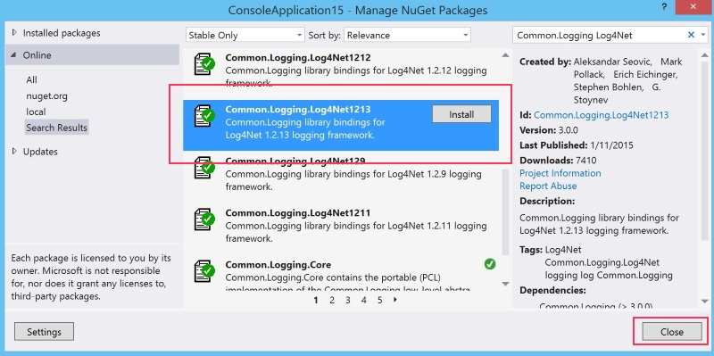
Installing Log4net
The Couchbase Client uses Log4Net
Log4Net is available via NuGet

Slide 55
Verbose Logging
Notes:
Focus on enabling verbose mode in the logs

